Slide 1
Sorting techniques Continue

Slide 2
Radix sort
Bucket Sort

Slide 3
Radix Sort

Slide 4
Radix Sort
The lower bound for Comparison based sorting algorithm (Merge Sort, Heap Sort, Quick-Sort .. etc) is Ω(nLogn), i.e., they cannot do better than nLogn.
Counting sort is a linear time sorting algorithm that sort in O(n+k) time when elements are in range from 1 to k.
Radix sort is used to sort numbers using 10 buckets for decimal numbers ranging 0 - 9.
The given numbers are first sorted according to the unit digit and this sorting process continues to the last digit (i.e. the most significant bit) in d-passes for d-digit numbers.
This sorting process continues to the last digit (i.e. the most significant bit) in d-passes for d-digit numbers.

Slide 5
Radix Sort
For a 5- digit numbers, radix sort places numbers in the bucket in 5 passes and combines the buckets five times.
Radix sort is sometimes used to sort records of information that are keyed by multiple fields (i.e. to sort dates by year, month and day).

Slide 6

Radix Sort Algorithm
Take the least significant digit of each key
Sort the list of elements based on that digit, but keep the order of elements with the same digit.
Repeat the sort with each more significant bit

Slide 7
Radix sort
Step 1 - Define 10 queues each representing a bucket for each digit from 0 to 9.
Step 2 - Consider the least significant digit of each number in the list which is to be sorted.
Step 3 - Insert each number into their respective queue based on the least significant digit.
Step 4 - Group all the numbers from queue 0 to queue 9 in the order they have inserted into their respective queues.
Step 5 - Repeat from step 3 based on the next least significant digit.
Step 6 - Repeat from step 2 until all the numbers are grouped based on the most significant digit.

Slide 8
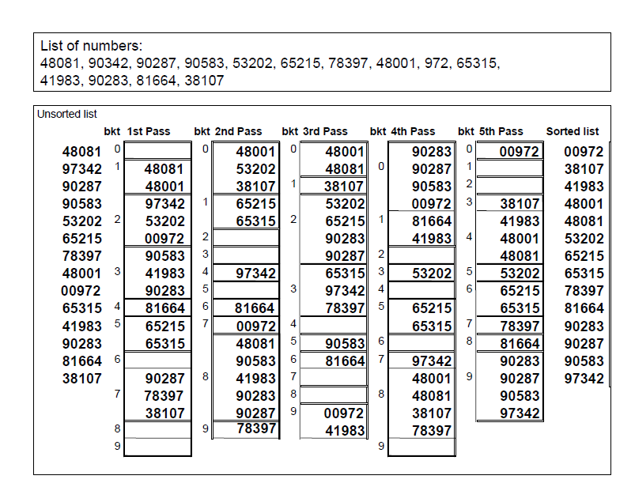
Numerical

Slide 9
Analysis
Number of Iterations = s*(d+n)
Where
d = Digits in a number (d=10 for decimal digit)
s = Number of digits in a number (s = 4 for 972, 8345 & 89 numbers)
n = Number of items (given numbers to be sorted)
Time depends upon comparisons, so time complexity is
O(n)

Slide 10
Analysis
How long does radix sort take?
There are now three parameters
n: the size of the array,
k: the base (in case of decimal number its 10),
now d, the number of digits.
Since counting sort takes O(k + n), which is O(n) for small k, and we do d counting sorts, radix sort takes O(n d) =O(n)

Slide 11
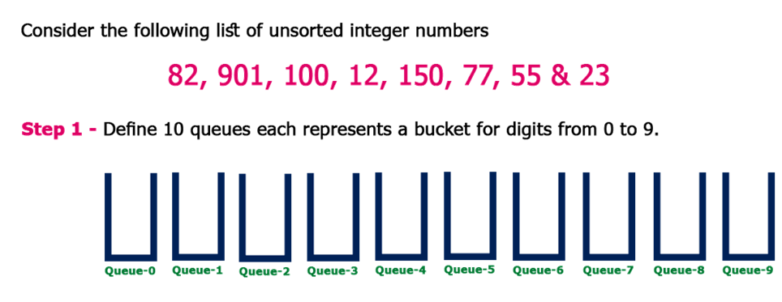

Slide 12
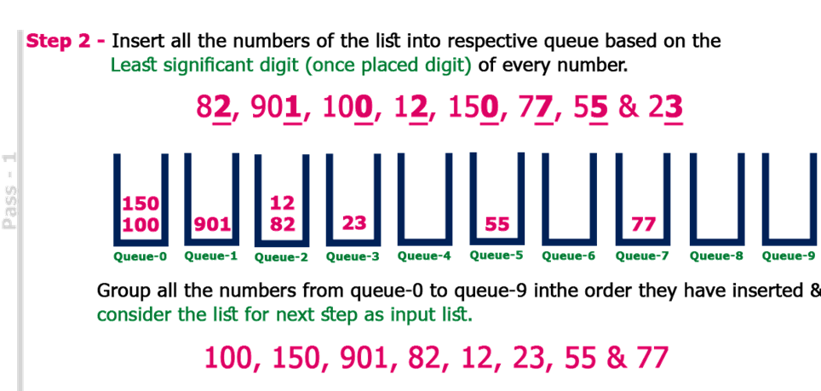

Slide 13
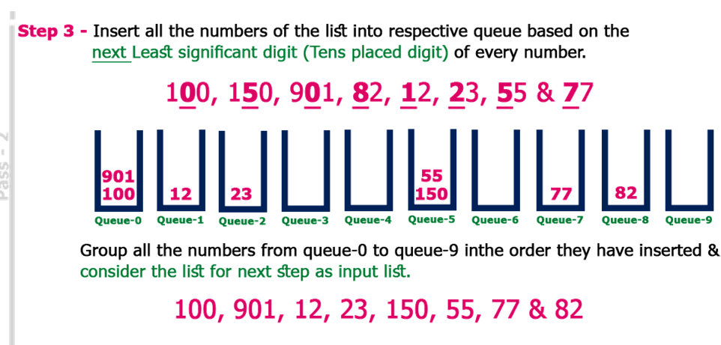

Slide 14
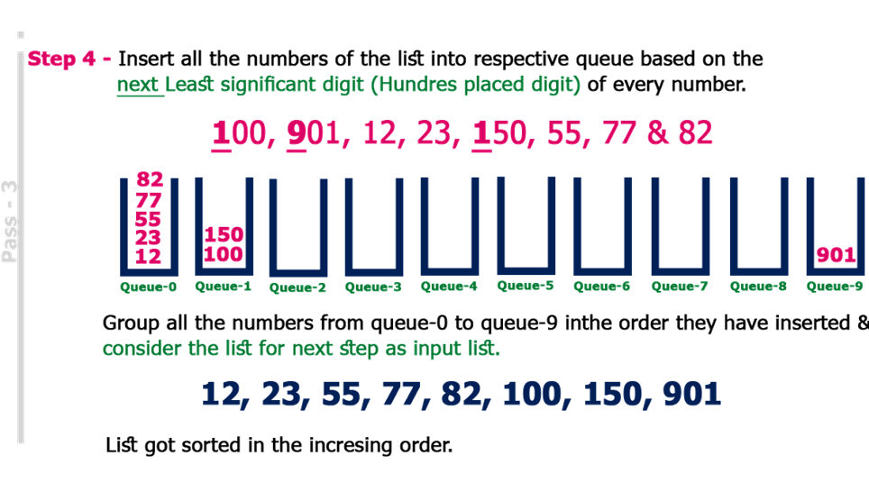

Slide 15
Task
COW,DOG,SEA,RUG,ROW,MOB,BOX,TAB,BAR,EAR,TAR,DIG,BIG, TEA,NOW,FOX

Slide 16
Solution
Keys | Pass 1 | Pass 2 | Pass 3
COW | SEA | TAB | BAR
DOG | TEA | BAR | BIG
SEA | MOB | EAR | BOX
RUG | TAB | TAR | COW
ROW | DOG | SEA | DIG
MOB | RUG | TEA | DOG
BOX | DIG | DIG | EAR
TAB | BIG | BIG | FOX
BAR | BAR | MOB | MOB
EAR | EAR | DOG | NOW
TAR | TAR | COW | ROW
DIG | COW | ROW | RUG
BIG | ROW | NOW | SEA
TEA | NOW | BOX | TAB
NOW | BOX | FOX | TAR
FOX | FOX | RUG | TEA

Slide 17
Task
DOC, SLEEPY, COW, HAPPY, JOY, CARD, SNOW, COLD

Slide 18
Bucket Sort

Slide 19
Bucket Sort
Bucket sort is another algorithm that expects something about the input just like count sort.
Bucket sort assumes that the input is generated by a random process that distributes elements uniformly and independently over the interval [0, 1).
Bucket sorts work well for data sets where the possible key values are known and relatively small and there are on average just a few elements per bucket.
It is mostly used to sort continuous numbers distributed uniformly.

Slide 20
Bucket sort
Bucket sort is a sorting technique in which array is partitioned into the buckets.
By this, each bucket will be sorted individually, by using some another stable sorting algorithm such as insertion sort.
This sorting technique assumes that the input is drawn from a uniform distribution by which it has an average case of O(n).
Since the inputs are uniformly and independently distributed over [0,1), we do not expect many numbers to fall into each bucket.

Slide 21

Bucket sort
Bucket sort assumes that the input is an n-element array A and that each element A[i] in the array satisfies $0 ≤ A[i] < 1$.
The code requires an auxiliary array B[0, … n-1] of linked lists (buckets) and assumes that there is a mechanism for maintaining such lists.

Slide 22
Bucket-Sort (A)
n = length [A]
2
for i = 1 to n
3
do insert A [i] into list B [n * A [i]]
4
for i = 0 to n - 1
5
do sort list B [i] with insertion sort
6 concatenate the lists B[0], B[1] ... B[n-1] together in order

Slide 23
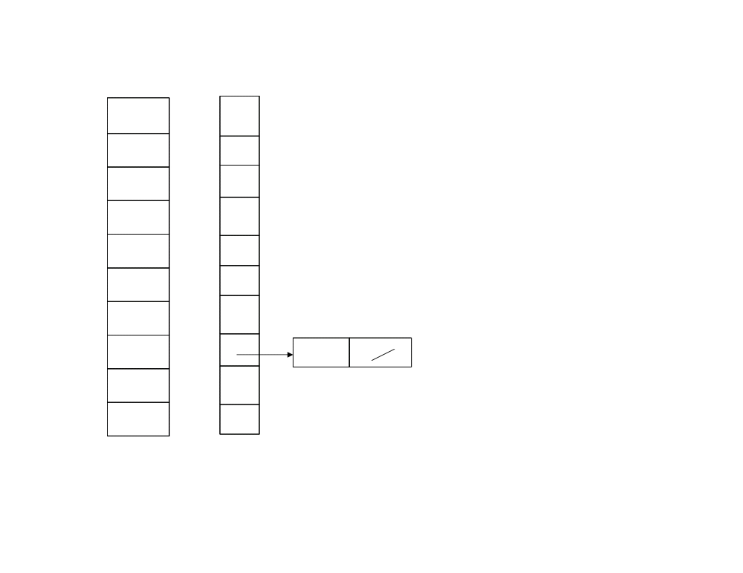
A
B
1 n = 10
2 for i = 1
1
.78
0
3 do insert A[1] into list B[10 * A [1]]
2
.17
1
3
.39
2
4
.26
3
5
.72
4
6
.94
5
7
.21
6
8
.12
7
.78
9
.23
8
10
.68
9

Slide 24
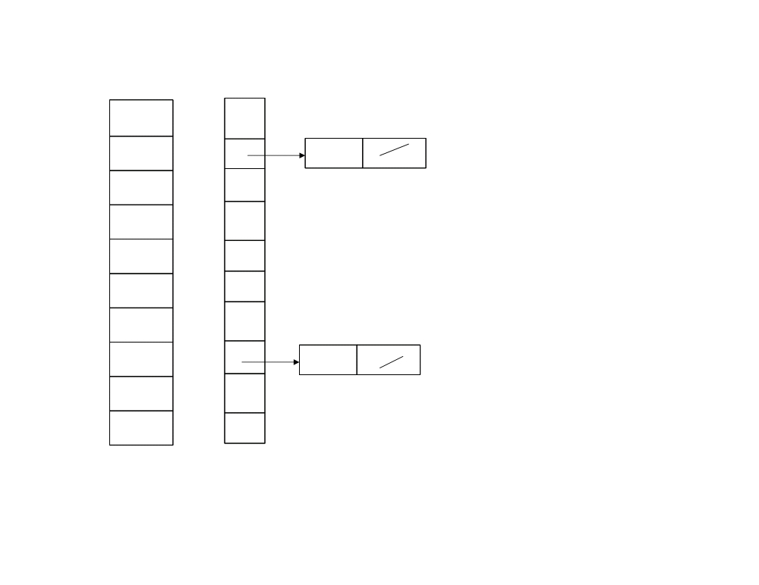
A
B
1 n = 10
2 for i = 2
1
.78
0
3 do insert A[2] into list B[10 * A [2]]
2
.17
1
.17
3
.39
2
4
.26
3
5
.72
4
6
.94
5
7
.21
6
8
.12
7
.78
9
.23
8
10
.68
9

Slide 25
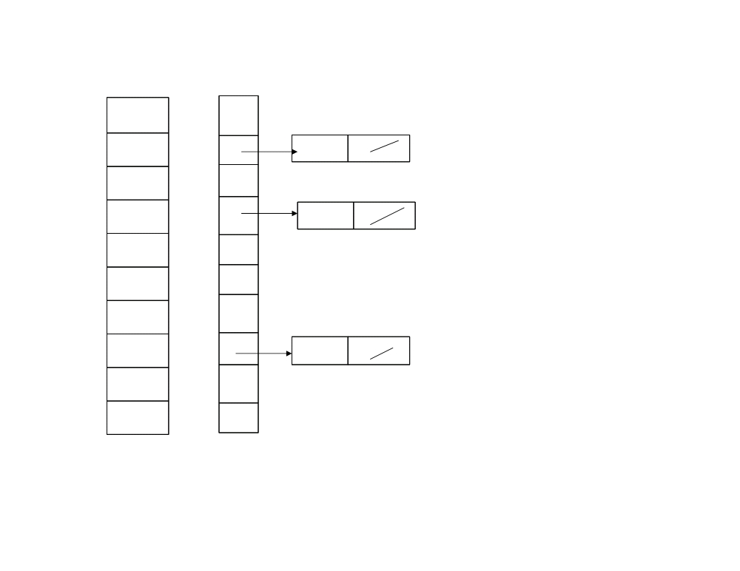
A
B
1 n = 10
2 for i = 3
1
.78
0
3 do insert A[3] into list B[10 * A [3]]
2
.17
1
.17
3
.39
2
4
.26
3
.39
5
.72
4
6
.94
5
7
.21
6
8
.12
7
.78
9
.23
8
10
.68
9

Slide 26
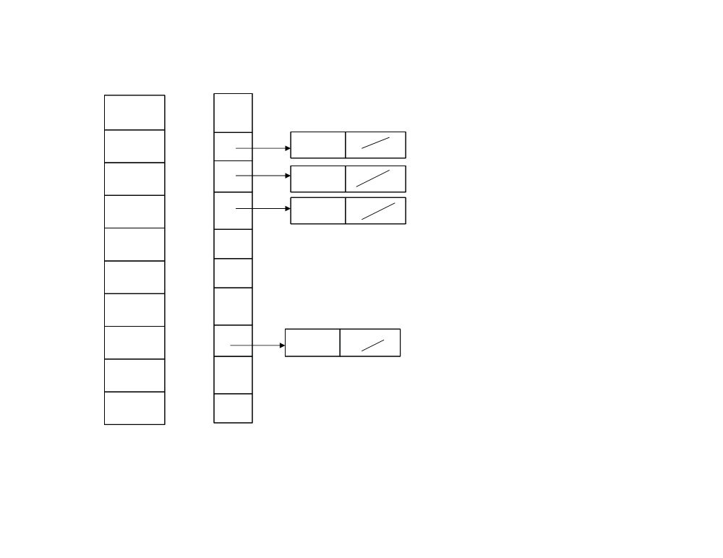
A
B
1 n = 10
2 for i = 4
1
.78
0
3 do insert A[4] into list B[10 * A [4]]
2
.17
1
.17
3
.39
2
.26
4
.26
3
.39
5
.72
4
6
.94
5
7
.21
6
8
.12
7
.78
9
.23
8
10
.68
9

Slide 27
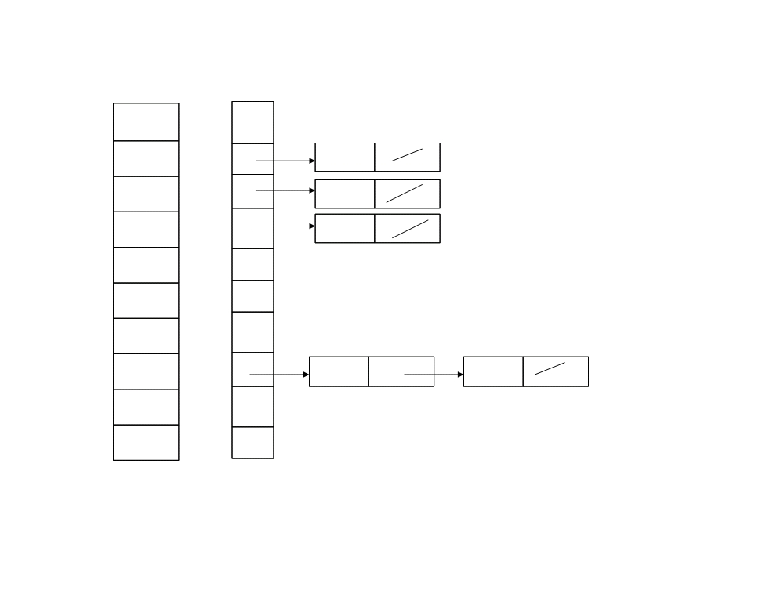
A
B
1 n = 10
2 for i = 5
1
.78
0
3 do insert A[5] into list B[10 * A [5]]
2
.17
1
.17
3
.39
2
.26
4
.26
3
.39
5
.72
4
6
.94
5
7
.21
6
8
.12
7
.78
.72
9
.23
8
10
.68
9

Slide 28
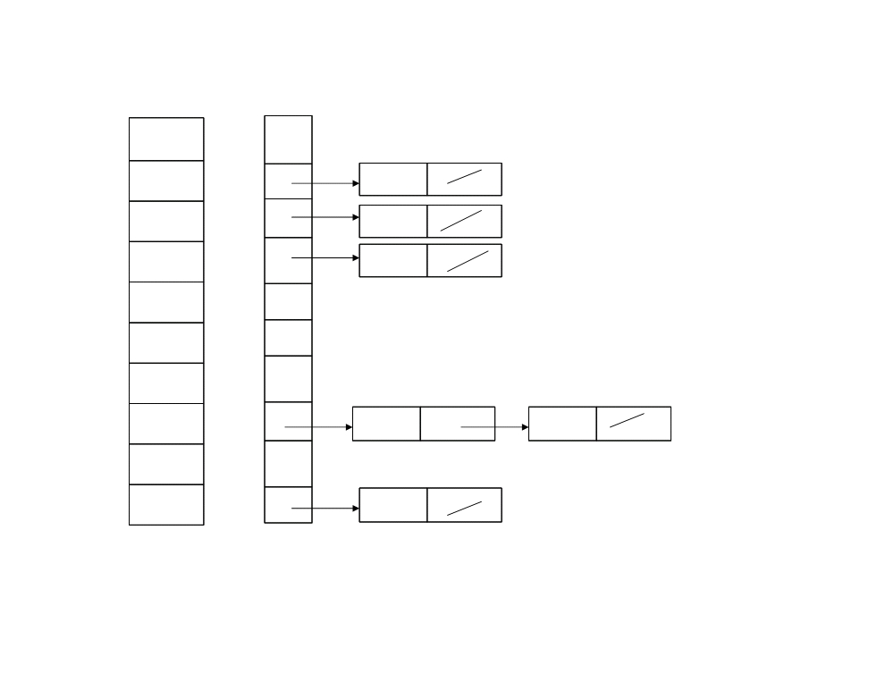
A
B
1 n = 10
2 for i = 6
1
.78
0
3 do insert A[6] into list B[10 * A [6]]
2
.17
1
.17
3
.39
2
.26
4
.26
3
.39
5
.72
4
6
.94
5
7
.21
6
8
.12
7
.78
.72
9
.23
8
10
.68
9
.94

Slide 29
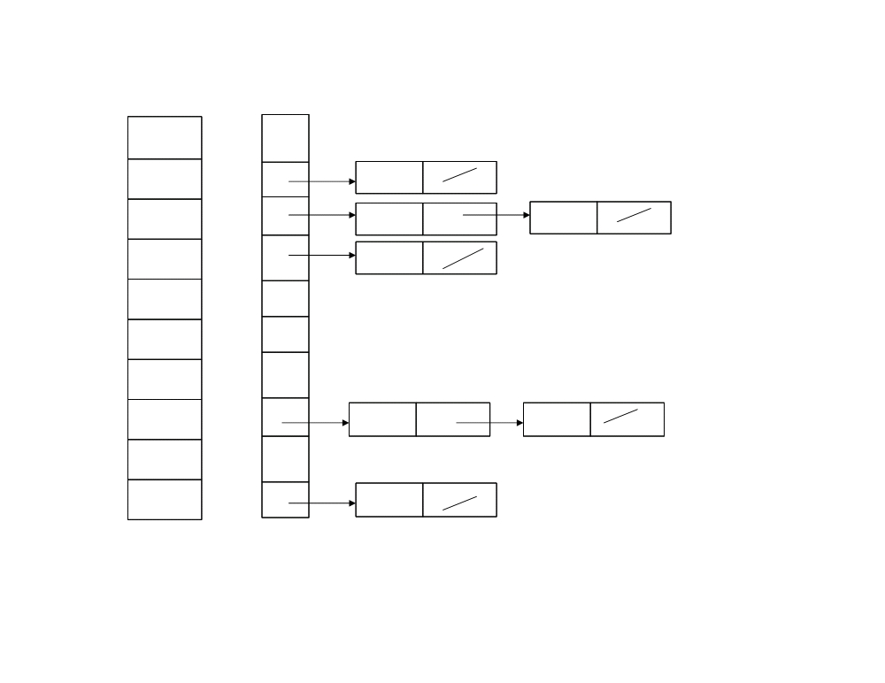
A
B
1 n = 10
2 for i = 7
1
.78
0
3 do insert A[7] into list B[10 * A [7]]
2
.17
1
.17
3
.39
2
.26
.21
4
.26
3
.39
5
.72
4
6
.94
5
7
.21
6
8
.12
7
.78
.72
9
.23
8
10
.68
9
.94

Slide 30
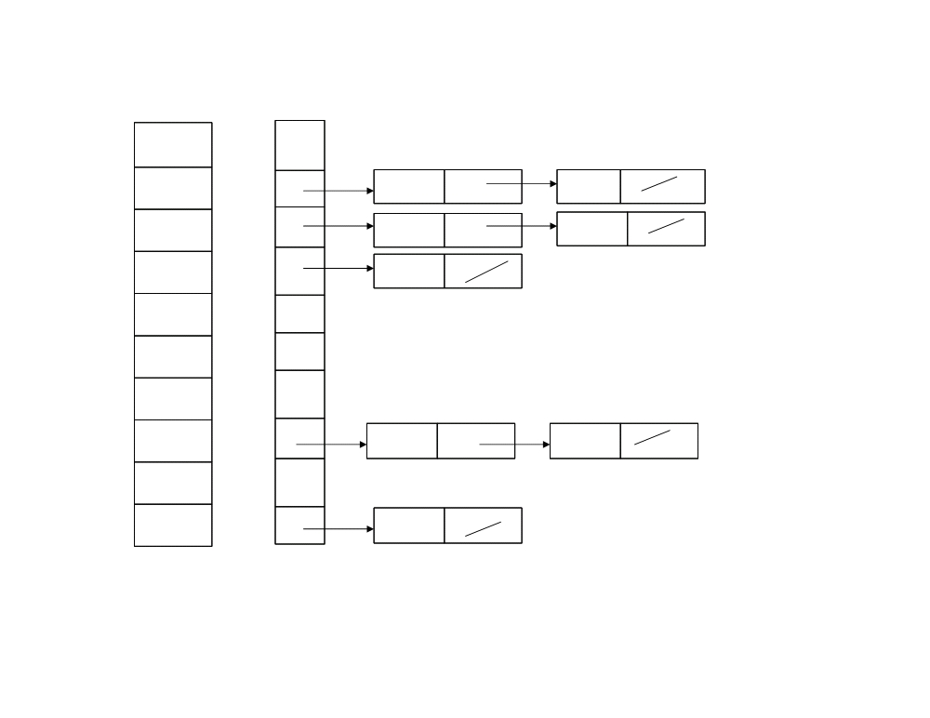
A
B
1 n = 10
2 for i = 8
1
.78
0
3 do insert A[8] into list B[10 * A [8]]
2
.17
1
.17
.12
3
.39
2
.26
.21
4
.26
3
.39
5
.72
4
6
.94
5
7
.21
6
8
.12
7
.78
.72
9
.23
8
10
.68
9
.94

Slide 31
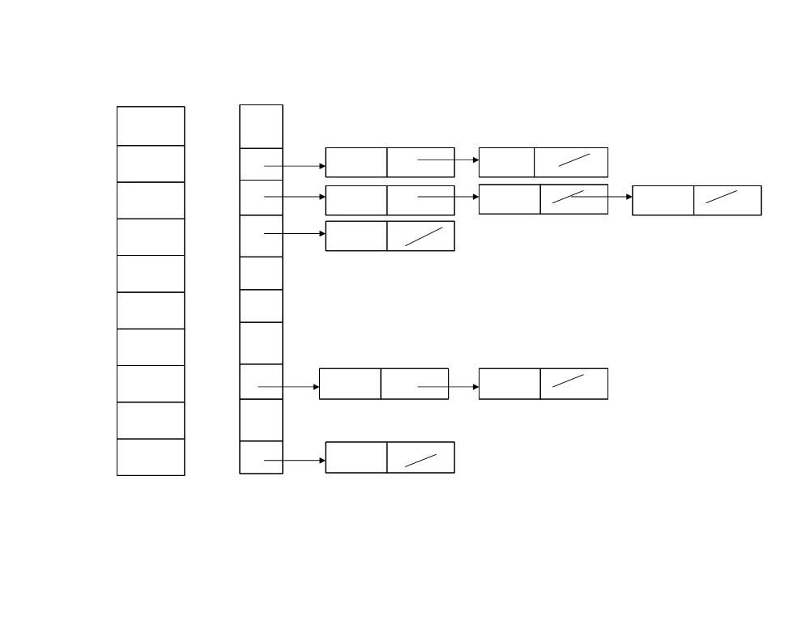
A
B
1 n = 10
2 for i = 9
1
.78
0
3 do insert A[9] into list B[10 * A [9]]
2
.17
1
.17
.12
3
.39
2
.26
.21 .23
4
.26
3
.39
5
.72
4
6
.94
5
7
.21
6
8
.12
7
.78
.72
9
.23
8
10
.68
9
.94

Slide 32
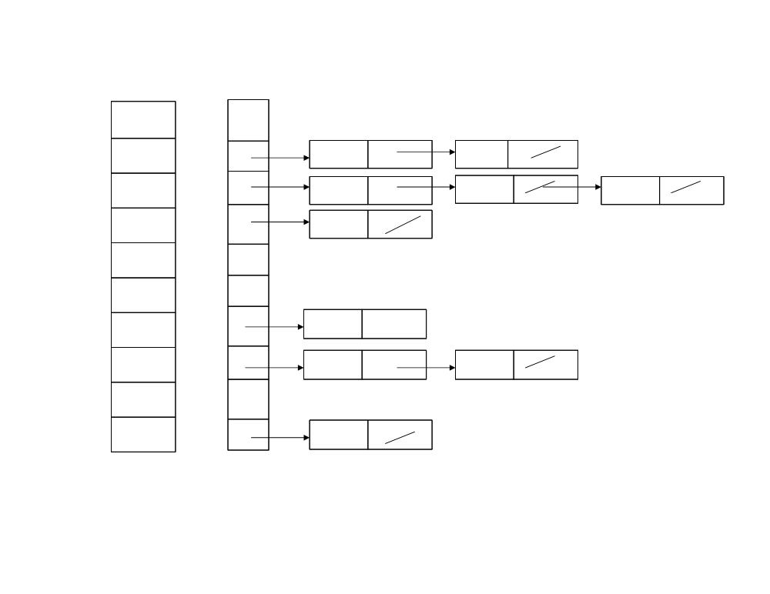
A
B
1 n = 10
2 for i = 10
1
.78
0
3 do insert A[10] into list B[10 * A [10]]
2
.17
1
.17
.12
3
.39
2
.26
.21 .23
4
.26
3
.39
5
.72
4
6
.94
5
7
.21
6
.68
8
.12
7
.78
.72
9
.23
8
10
.68
9
.94

Slide 33
A
B
4 - i = 0
5 - do sort list B[0] with insertion sort
1
.78
0
2
.17
1
.17
.12
3
.39
2
.26
.21 .23
4
.26
3
.39
5
.72
4
6
.94
5
7
.21
6
.68
8
.12
7
.78
.72
9
.23
8
10
.68
9
.94

Slide 34
A
B
4 - i = 1
5 - do sort list B[1] with insertion sort
1
.78
0
2
.17
1
.12
.17
3
.39
2
.26
.21 .23
4
.26
3
.39
5
.72
4
6
.94
5
7
.21
6
.68
8
.12
7
.78
.72
9
.23
8
10
.68
9
.94

Slide 35
A
B
4 - i = 2
5 - do sort list B[2] with insertion sort
1
.78
0
2
.17
1
.12
.17
3
.39
2
.21
.23 .26
4
.26
3
.39
5
.72
4
6
.94
5
7
.21
6
.68
8
.12
7
.78
.72
9
.23
8
10
.68
9
.94

Slide 36
A
B
4 - i = 3
5 - do sort list B[3] with insertion sort
1
.78
0
2
.17
1
.12
.17
3
.39
2
.21
.23 .26
4
.26
3
.39
5
.72
4
6
.94
5
7
.21
6
.68
8
.12
7
.78
.72
9
.23
8
10
.68
9
.94

Slide 37
A
B
4 - i = 4
5 - do sort list B[4] with insertion sort
1
.78
0
2
.17
1
.12
.17
3
.39
2
.21
.23 .26
4
.26
3
.39
5
.72
4
6
.94
5
7
.21
6
.68
8
.12
7
.78
.72
9
.23
8
10
.68
9
.94

Slide 38
A
B
4 - i = 5
5 - do sort list B[5] with insertion sort
1
.78
0
2
.17
1
.12
.17
3
.39
2
.21
.23 .26
4
.26
3
.39
5
.72
4
6
.94
5
7
.21
6
.68
8
.12
7
.78
.72
9
.23
8
10
.68
9
.94

Slide 39
A
B
4 - i = 6
5 - do sort list B[6] with insertion sort
1
.78
0
2
.17
1
.12
.17
3
.39
2
.21
.23 .26
4
.26
3
.39
5
.72
4
6
.94
5
7
.21
6
.68
8
.12
7
.78
.72
9
.23
8
10
.68
9
.94

Slide 40
A
B
4 - i = 7
5 - do sort list B[7] with insertion sort
1
.78
0
2
.17
1
.12
.17
3
.39
2
.21
.23 .26
4
.26
3
.39
5
.72
4
6
.94
5
7
.21
6
.68
8
.12
7
.72
.78
9
.23
8
10
.68
9
.94

Slide 41
A
B
4 - i = 8
5 - do sort list B[8] with insertion sort
1
.78
0
2
.17
1
.12
.17
3
.39
2
.21
.23 .26
4
.26
3
.39
5
.72
4
6
.94
5
7
.21
6
.68
8
.12
7
.72
.78
9
.23
8
10
.68
9
.94

Slide 42
A
B
4 - i = 9
5 - do sort list B[9] with insertion sort
1
.78
0
2
.17
1
.12
.17
3
.39
2
.21
.23 .26
4
.26
3
.39
5
.72
4
6
.94
5
7
.21
6
.68
8
.12
7
.72
.78
9
.23
8
10
.68
9
.94

Slide 43

Bucket-Sort (A)
1 n = length [A]
2
for i = 1 to n
3
do insert A [i] into list B [n * A [i]]
4
for i = 0 to n - 1
5
do sort list B [i] with insertion sort
6 concatenate the lists B[0], B[1] ... B[n-1] together in order

Slide 44
Analysis of Bucket Sort
All lines except line 5 takes O(n) time in worst case
n_{i} be the random variable denoting number of elements in the bucket B[i]
Expected time to sort the elements in Bucket B[i] in worst case is E(O(n_{i})²)
For the average case, we take the expectation over the input into account that each bucket will be linear to number of elements to be sorted in the array.
Even if the input is not drawn from a uniform distribution, bucket sort may still run in linear time. As long as the input has the property that the sum of the squares of the bucket sizes is linear in the total number of elements bucket sort will run in linear time.

Slide 45
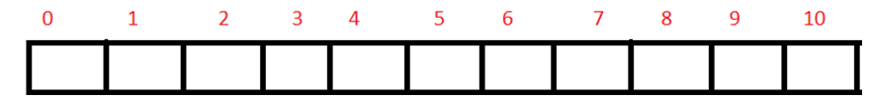
Example
Let us sort the elements by using bucket sort. Elements which need to be sort are 56, 12, 84, 28, 0,-13, 47, 94, 31, 12.

Slide 46
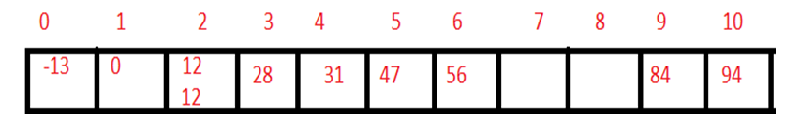
Now consider the range such that:
-20 to -1, 0 to 10 10 to 20, 20 to 30, 30 to 40, 40 to 50, 50 to 60, 60 to 70, 70 to 80, 80 to 90, 90 to 100.
For values 56, 12, 84, 28, 0,-13, 47, 94, 31, 12.

Slide 47
Task to submit before coming class
Application areas of both buckets and radix sort
Pros and cons of bucket and radix sort algorithm

Slide 48
Summary
Bucket sort performs at its worst, O(n^{​2}​​), when all elements at allocated to the same bucket.
What if we want to preserve the linear time for the best, and nlgn for the worst? What changes we need to done? This depends on the individual implementation though and can be mitigated. For example, a bucket sort algorithm could be made to work with large bucket sizes by using insertion sort on small buckets, and merge sort or quicksort on larger buckets.
Radix sorting is fantastic at sorting huge volumes of data. When the number of records, N, gets big enough, and there are plenty of values to sort, it's great.
Radix sort is suitable when number of digits in keys are same
Radix sort is not suitable when many keys are duplicate.

